Slide 1


Capstone Project Phase 1
Parkinson's Perspective: Visualizing Impact
Students:
Omer Fatal
Tanya Gendelman
Supervisors:
Dr. Julia Sheidin
Dr. Avital Shulner
Project Code: 25-1-D-6
1

Slide 2
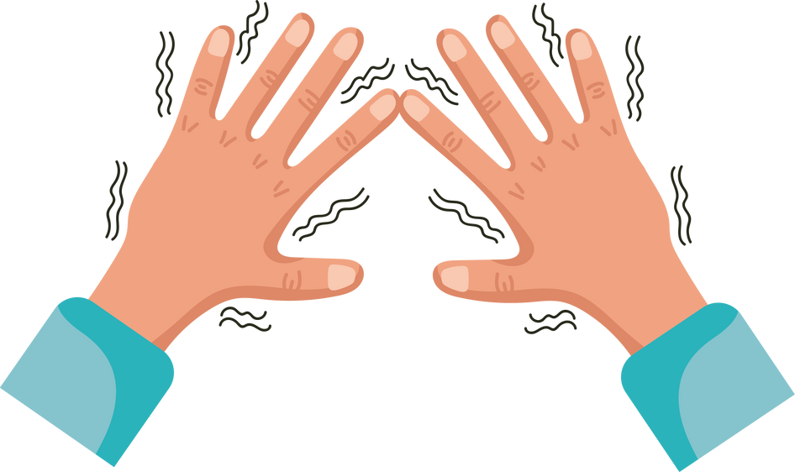
Introduction
Parkinson’s disease is a progressive neurological condition that affects movement, coordination, and balance.
PD significantly impacts patients' daily lives, both physically and emotionally.
Motor symptoms like tremors, stiffness, and slowness make everyday tasks, such as walking or eating, more challenging.
Non-motor symptoms, such as anxiety, depression, and trouble sleeping, lower the overall quality of life.
The progressive nature of the disease often leads to a loss of independence, increased reliance on caregivers, and feelings of social isolation.
2

Slide 3
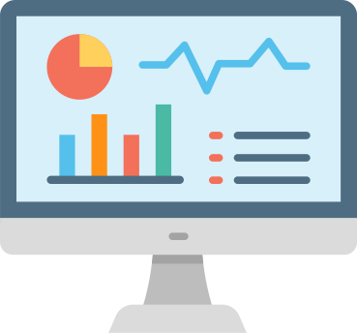
Our Goal
Effectively managing Parkinson’s requires monitoring daily activities and symptoms changes, but current tools are often lack clarity and fail to provide personalized useful insights.
Our project addresses this problem by creating clear, interactive visualizations, such as heatmaps and graphs that empower patients to track progress, identify patterns, and optimize their daily routines.
We aim to enhance usability and personalization, ensuring that the system meets the specific needs of patients by adapting visualizations and insights to their daily experiences.
This project builds on the work of the previous work, which focused on collecting data from Parkinson’s patients.
3

Slide 4

Importance of Explanations in PD Management
Many Parkinson’s patients struggle to link daily choices to symptoms. The lack of personalized insights makes care decisions more challenging.
Textual and visual explanations address different patient needs effectively:
Textual explanations simplify information, easing anxiety and boosting confidence.
Visual explanations such graphs reveal patterns, helping patients understand trends.
These tools help patients improve routines for better management.
4

Slide 5

Existing Solutions
We reviewed and analyzed various tools for Parkinson’s data visualization such as “DataPark”, “PD-Insighter”, and dashboards.
DataPark: Shows energy, activity, and sleep trends but lacks personalized insights.
Dashboards: Tracks medication and symptoms but primarily targets clinicians.
PD-Insighter: Analyzes motor patterns but focuses on clinicians, not patients.
While these tools provide valuable insights into Parkinson's management, they lack a patient-centered approach, focusing more on clinical needs than empowering individuals to manage their daily lives.
5

Slide 6

Expected Achievements
The goal of this project is to empower Parkinson's patients by providing a platform to visualize and understand how their daily activities impact their symptoms.
Transform raw data into clear, interactive visualizations.
Design an intuitive and user-friendly interface.
Encourage patient engagement and routine improvement.
6

Slide 7

Engineering Process
Reviewing Michael’s Excel file, taken from the project book of the previous project, which documented daily activities over several months.
Analyzing existing resources and conducting a literature review to guide the visualization design.
Exploring various data visualization tools to identify intuitive and accessible methods for presenting the data.
Categorizing the data into six key groups: Physical Activity, Nutrition, Rest and Sleep, Medication, Symptoms, and Feeling Scores.
7

Slide 8
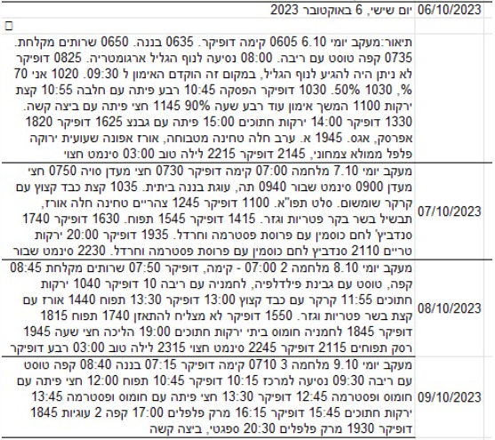
Collected Patient Data
8

Slide 9

Our Solution
Our solution will be a fully responsive web-based system accessible on both mobile and desktop devices, ensuring seamless use across platforms.
It will feature a user-friendly interface designed for intuitive navigation and interaction.
Interactive visualizations like heatmaps and graphs will help patients track progress, identify patterns, and optimize their daily routines.
9

Slide 10
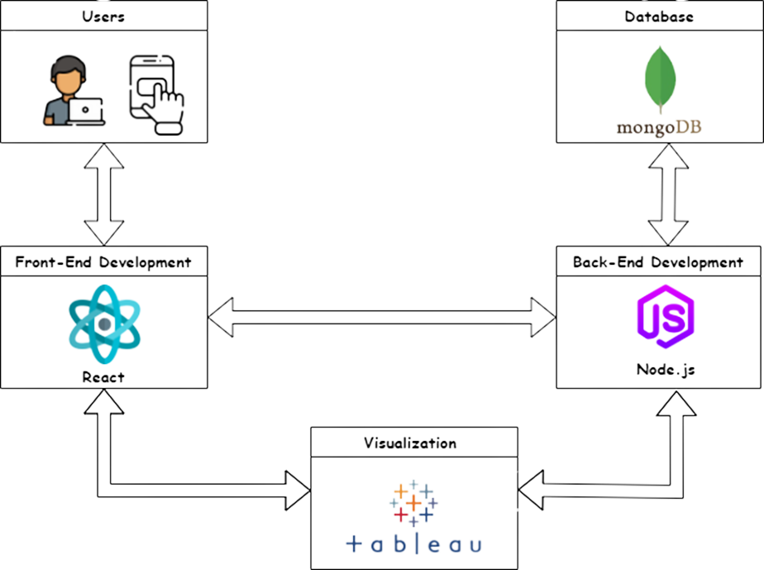
System Architecture
The system will include React for the frontend, Node.js for the backend, MongoDB as the database, and Tableau for visualization.
10

Slide 11
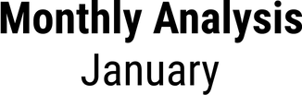
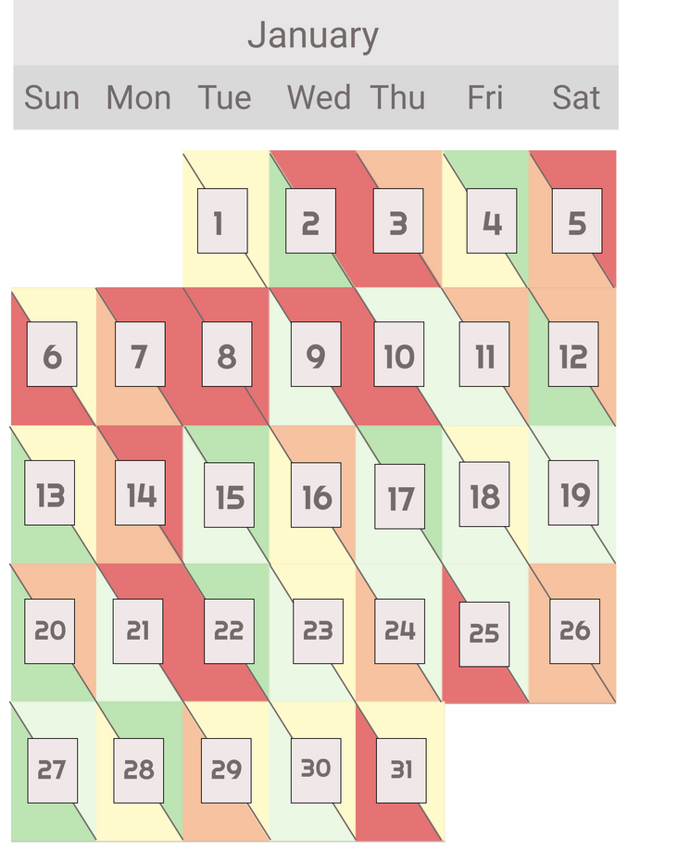

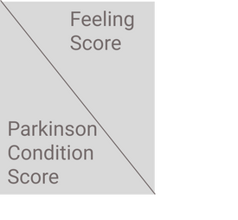

Prototype Screens
Monthly Analysis Screen: This is the main screen that contains the "Monthly Feeling and Parkinson Score Overview".
11

Slide 12
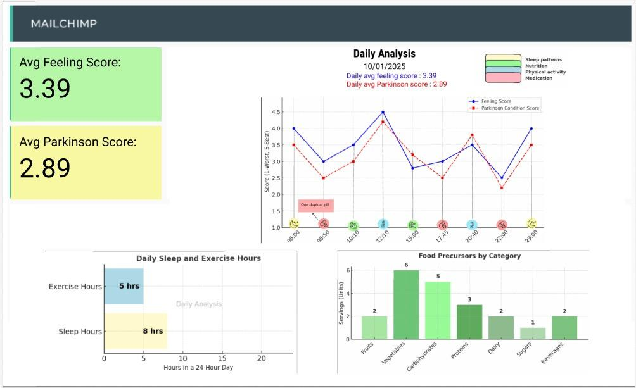
Prototype Screens
Dashboard Screen: This screen provides detailed visualizations and textual explanations for the chosen day.
12

Slide 13
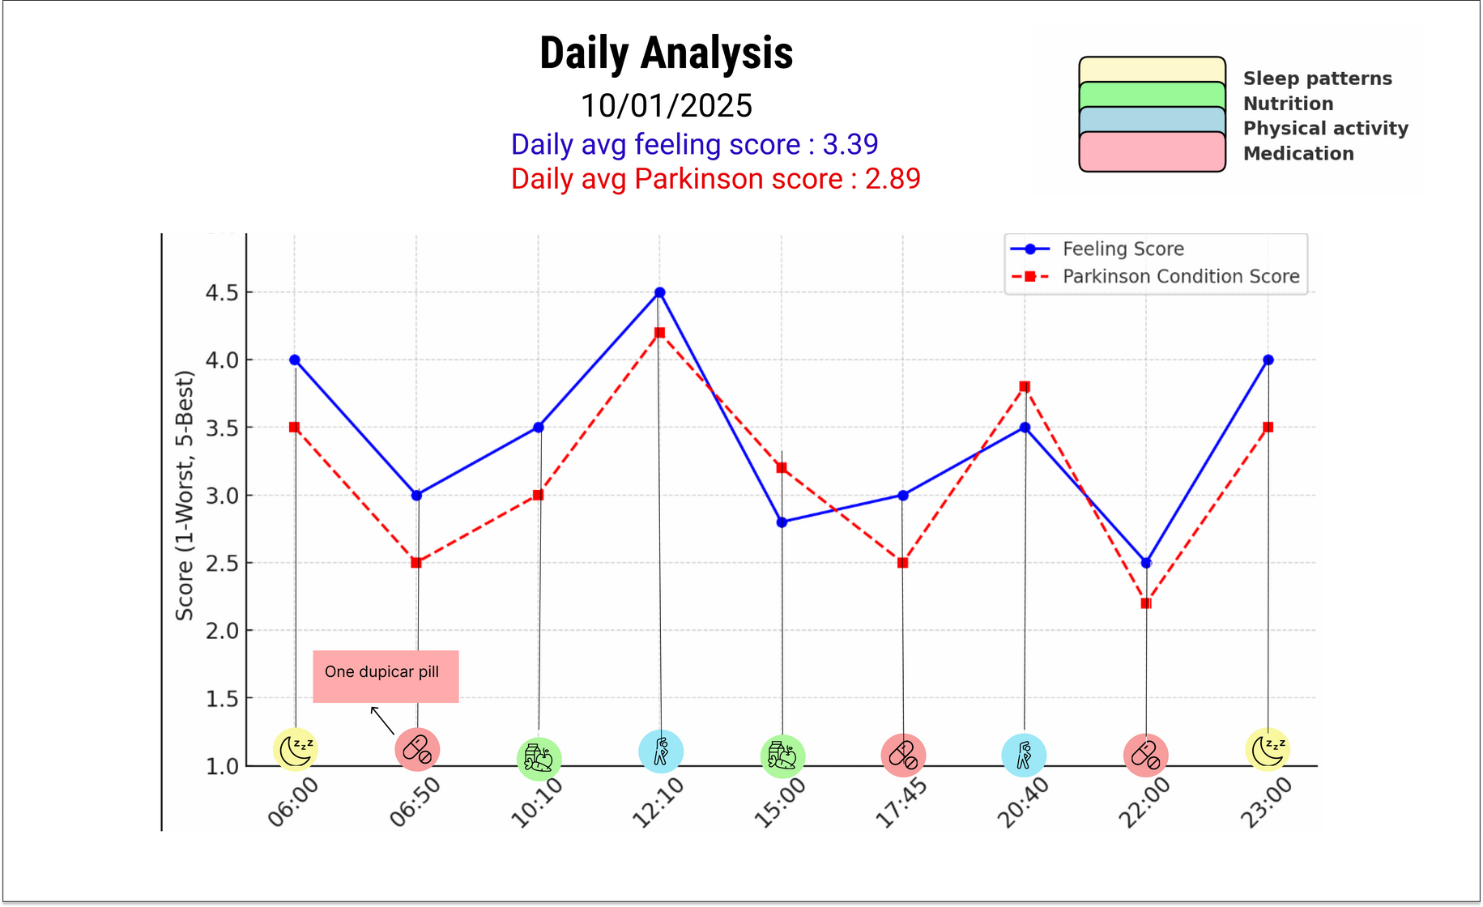
Prototype Screens
Daily Analysis Graph: This line graph maps activities alongside their corresponding Feeling Scores and Parkinson's Condition Scores throughout the day.
13

Slide 14
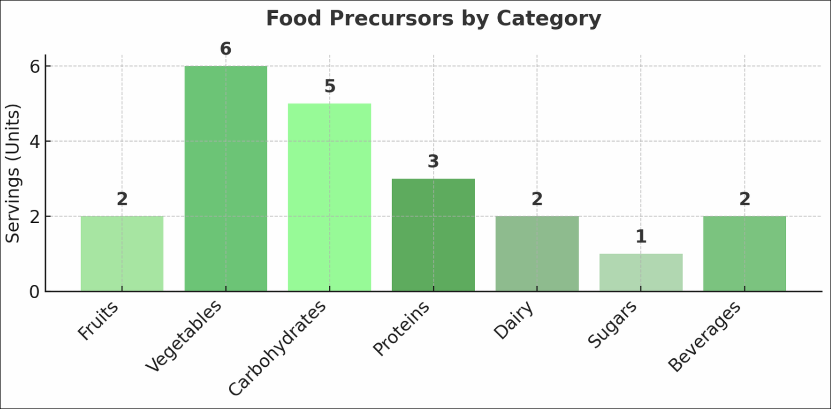
Prototype Screens
Food Precursors chart: This bar chart summarizes the servings consumed from various food categories throughout the day
14

Slide 15
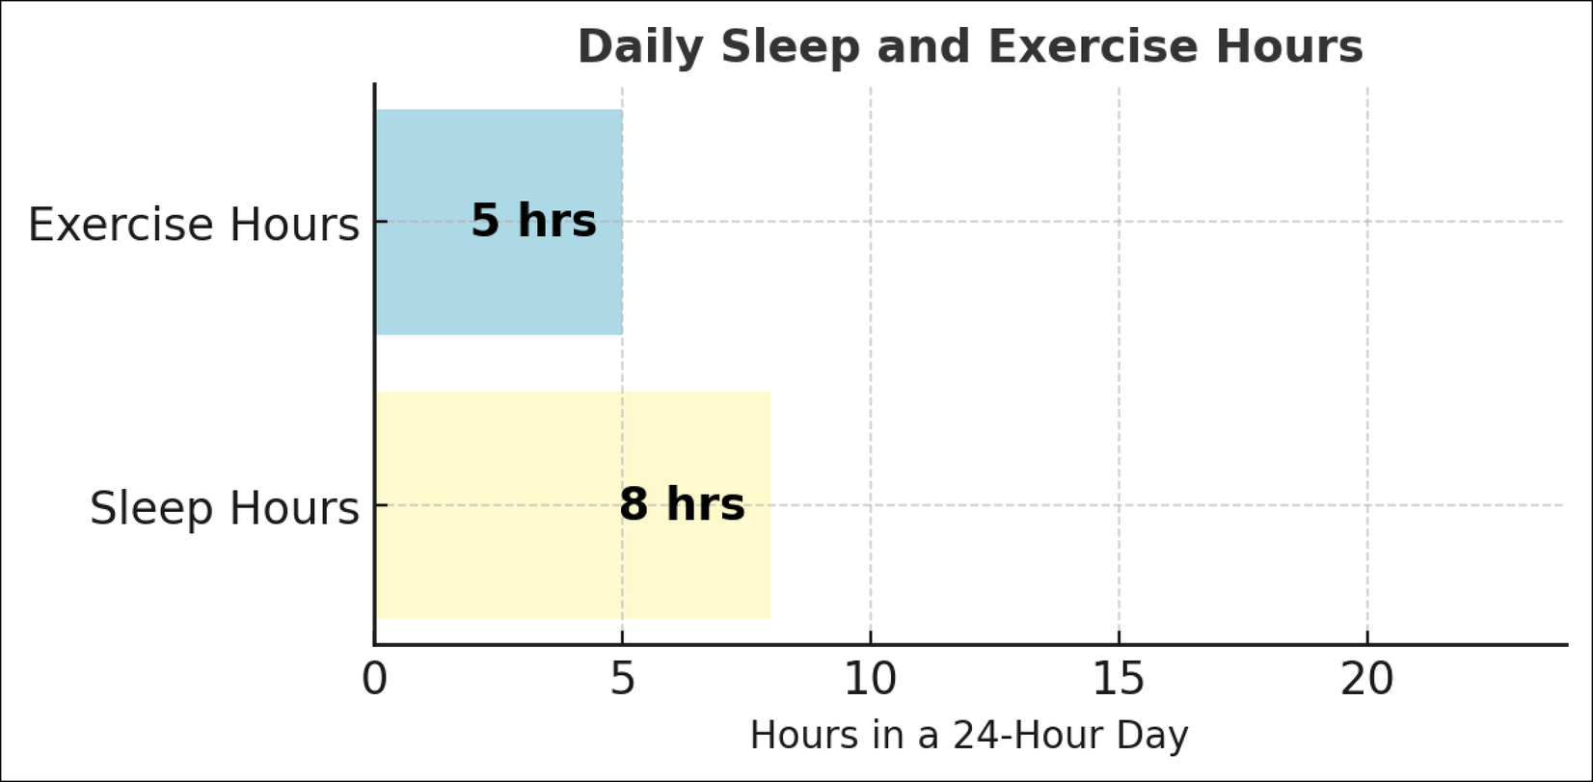
Prototype Screens
Daily Sleep and Exercise Hours graph: This bar chart shows the daily distribution of hours spent on sleep and exercises.
15

Slide 16
Meeting with Michael
All the screens we have shown so far are early prototypes made to track Parkinson’s symptoms and daily activities. After our meeting with Michael, we received helpful feedback about tracking food, sleep, exercise, and symptom changes during the day. In the next phase of the project, we will make changes to improve how the information is shown, separate different types of data more clearly, and make the system easier to understand. These updates will help create a more useful and personalized tool for patients.
16

Slide 17

Expected Challenges
Our project faces three main challenges:
Connecting to the collected data – We need to integrate data from the previous phase, either by using the existing database or building a new independent system with a custom database and upload feature.
Creating clear and intuitive visualizations – The data must be easy to understand and provide useful insights for tracking Michael’s condition.
Handling complex and dynamic data – Since the data constantly changes, we must present it in a simple and accessible way that allows Michael to interpret it easily.
Addressing these challenges will help us build a user-friendly and effective system for managing Parkinson’s data.
17

Slide 18
Testing Plan
# | Test Subject | Test Headline | Expected Results
1 | Data Visualization | View Heatmap. | The system displays an interactive heatmap showing daily and monthly scores clearly.
2 | Data Visualization | View Line Chart. | The line chart shows fluctuations in feelings and conditions over a day.
3 | Data Visualization | View Bar Chart. | The bar chart displays a breakdown of activity categories accurately.
4 | Dashboard Navigation | Navigate between visualizations on the dashboard. | The transition between screens is intuitive.
5 | Multiple Visualization Views | Display multiple visualizations simultaneously. | The dashboard renders multiple charts without performance issues.
6 | Screen Transition | Ensure smooth navigation between screens. | The system allows movement between screens without delays.
18

Slide 19

Patient Evaluation – Michael’s Review
Usability Testing – Michael will test the system to see if it is easy to use and navigate.
Data Clarity – He will evaluate whether the visualizations clearly present the information he needs.
Relevance to Daily Needs – The system will be checked to ensure it aligns with his daily tracking requirements.
Identifying Improvements – His feedback will help us refine and adjust the system for better usability.
Final Validation – Ensuring that the platform meets the conditions and expectations he defined.
This evaluation is essential for making the system more practical, intuitive, and tailored to Michael’s needs.
19

Slide 20
Thank You
For your attention
20

